Slide 1
Section 7.7: Improper Integrals

Slide 2
If makes sense, then what about ?
Definition
This is our first example of an improper integral.

Slide 4
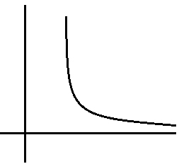
If the limit is finite then we say that
the improper integral converges
otherwise the integral diverges.
Notice that if the integral is going to converge,
Zero must be a horizontal asymptote
and the function must get small quickly.

Slide 5
Fact

Slide 6
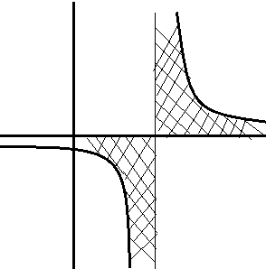
Vertical Asymptotes provide another kind of improper integral.
You always have to check that the function is continuous.
Diverges, but if we ignore the asymptote, we get the wrong answer:

Slide 7
Third Type

Slide 8
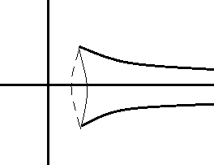
Gabriel’s horn
Rotate f(x) = 1/x about x-axis
Volume =
Surface Area =
Diverges!!
This is a paint can that can be filled with π unit³ of paint,
but the surface requires an infinite amount of paint!

